Slide 1
GROUP WORK
Power BI
Data Analysis Report
Retail Orders Dashboard · Sales & Profit Intelligence
Data Overview
Transformations
Data Model
Visual Encoding

Slide 2

“Data Visualization & Modelling of Global Superstore Dataset”
By
Ayishath Thasneem Mashoora (M01089567)
Esther Maina(M01088206)
Kusum Anil Vishwakarma(M1093046)
DATA VISUALISATION,COMPUTER VISION AND IMAGING – CST4245
SUDHAKAR FERNANDO
22-02-2026 11:59 PM

Slide 3
01
DATA OVERVIEW
Tables, fields and raw data structure

Slide 4
Data Tables Overview
Section 1 · Data Overview
📦 Orders
↩️ Returns
Fact Table
Fact (lookup)
Order ID, Order Date, Ship Date, Ship Mode, Segment, Country, Region, Category, Sub-Category, Sales, Quantity, Discount, Profit, Market
Returned, Order ID, Market
🏷️ DimProduct
📅 Date
Dimension
Date Dimension
Product ID, Category, Sub-Category, Product Name
Date, Year, Quarter, Month, Day (auto-generated date table)
👤 People
Dimension
Person, Region
Power BI · Group Work Data Analysis Report

Slide 5
Key Measures & KPI Fields
Section 1 · Data Overview
TOTAL SALES
TOTAL PROFIT
PREV YEAR SALES
YoY GROWTH
TotalSales
TotalProfit
PreviousYearSales
YearOverYearGrowth
DAX measure – sum of all sales
DAX measure – aggregated net profit
Time intelligence measure
Year-over-year % comparison
This section represents the key performance indicators (KPIs) used to evaluate the business performance and the growth patterns.
Total Sales represents the overall revenue generated from all the transactions.it serves as an initial indicator of business volume and demand in market.
Total Profit is the measure of net financial profit after accounting the costs and discounts.it showcases the economic efficiency of sales activities and supports profitability . Previous Year Sales is a time – intelligence measure which captures the sales performance for the same intervals in the prior year. It helps in comparing the historical sales and recent growth respectively.
Year-over-Year (YoY) calculates the ratio of change in sales between current and previous year. IT provides clear insights about dynamic growth and different trends.
All together these KPIs boosts multidimensional performance evaluation by combining absolute metrics (sales and profit) with comparative metrics(YoY) growth, making these a great support for the strategic and operational decision-making.
Power BI · Group Work Data Analysis Report

Slide 6
02
DATA TRANSFORMATIONS
Power Query steps & DAX calculations

Slide 7
Power Query – Data Transformation Steps
Section 2 · Transformations
📂 1. Data Ingestion
🔤 2. Column Renaming & Type Assignment
Loaded Orders, Returns, People and DimProduct tables from CSV/Excel source files via Power Query connectors.
Renamed raw column headers for clarity. Assigned explicit data types: Date for Order/Ship Date, Decimal Number for Sales/Profit/Discount, Whole Number for Quantity.
🔗 3. Merging / Joining Tables
🗺️ 4. Geo Hierarchy Construction
Orders joined to DimProduct on Product ID to bring in Category and Sub-Category fields. Returns integrated via Order ID for return analysis.
Built a Geo Hierarchy across Market → Region → Country fields in the Orders table to enable drill-down in map and chart visuals.
📅 5. Date Table Creation
🧹 6. Null Handling & Filtering
Auto-generated Date dimension table (Date, Year, Quarter, Month, Day) and marked it as the official date table. Linked to Orders[Order Date] for time intelligence.
Removed rows with null Order IDs. Filtered out cancelled/invalid orders. Applied data quality rules to ensure referential integrity.
Power BI · Group Work Data Analysis Report

Slide 8
03
DATA MODELLING
Star schema structure & table relationships

Slide 9
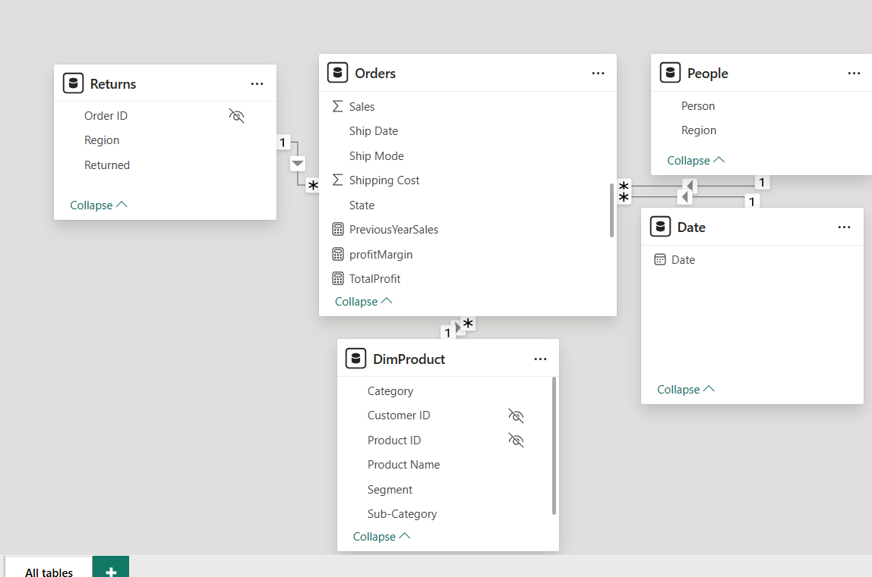
Data Model – Star Schema Approach
Section 3 · Data Modelling
Relationship Types:
Orders <-> Returns :One-to-Many
Orders <-> DimProduct :Many-to-One
Orders <-> People : Many-to-One
Orders <-> Date :Many-to-One
Overall Model Type: Star Schema (Orders = Fact table; others = Dimension tables)
Power BI · Group Work Data Analysis Report

Slide 10
04
REPORT VISUALS
What each chart shows, why it was chosen & how it works

Slide 11
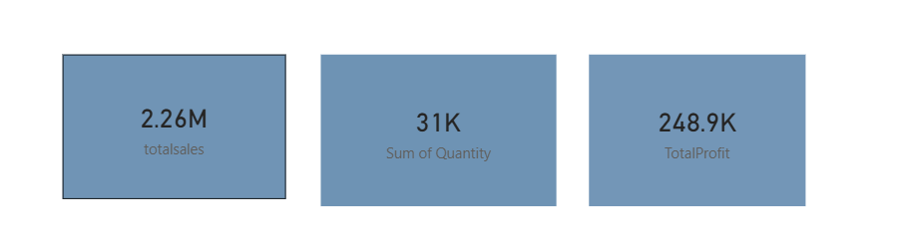
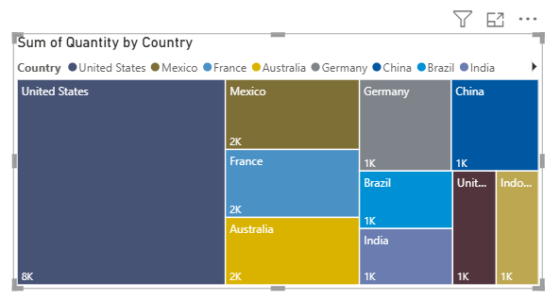
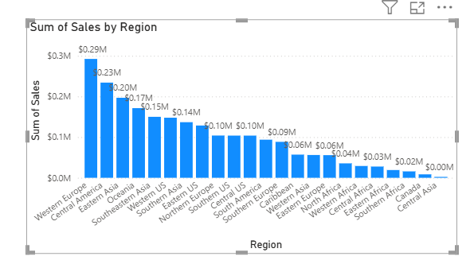
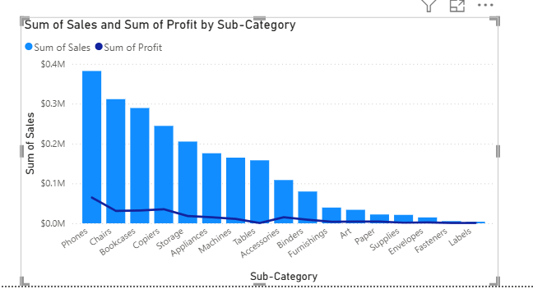
Year 2012

Slide 12
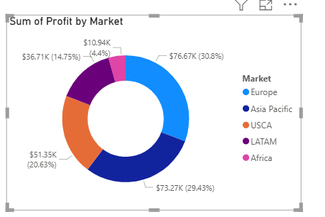
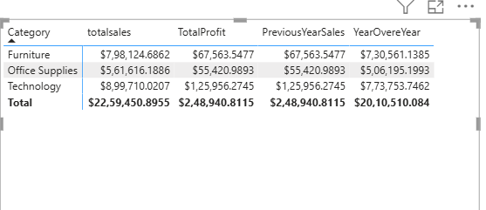

Slide 13
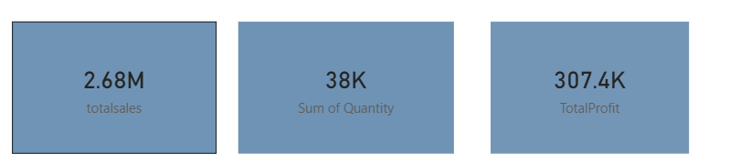
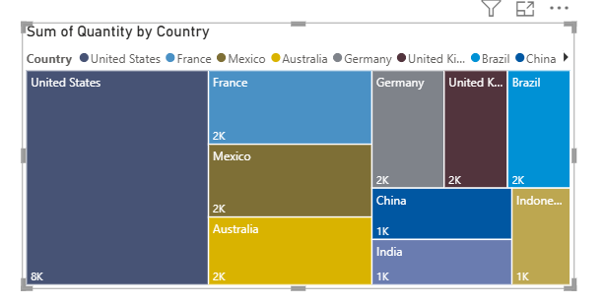
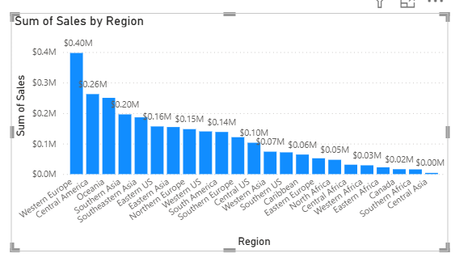
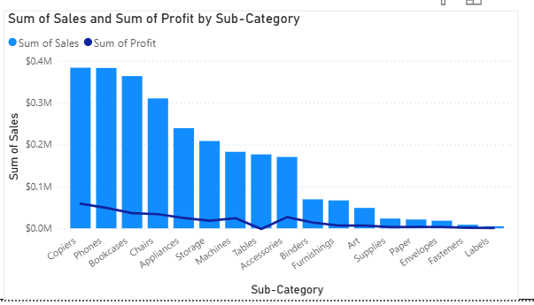
Year 2013

Slide 14
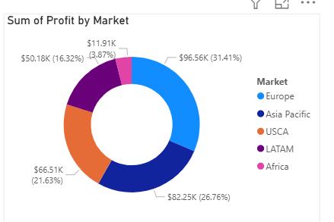
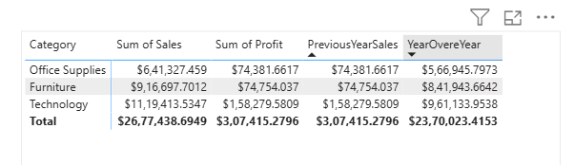

Slide 15
Year 2014

Slide 16
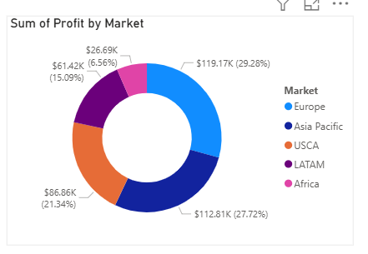
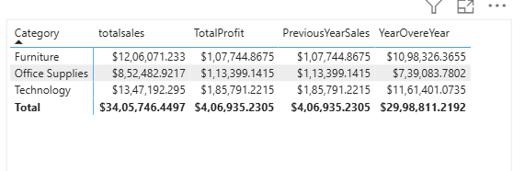

Slide 17
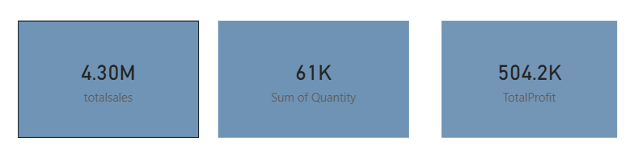
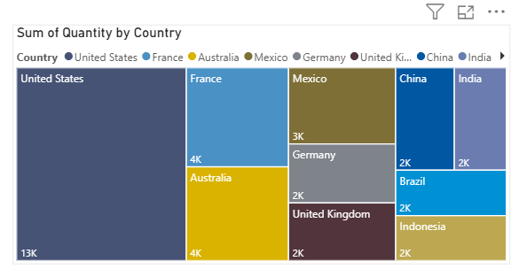
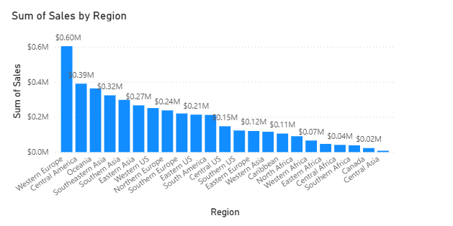
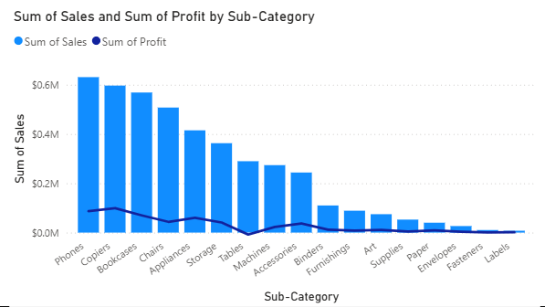
Year 2015

Slide 18
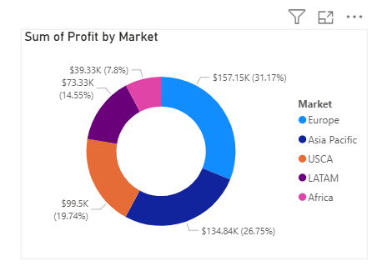
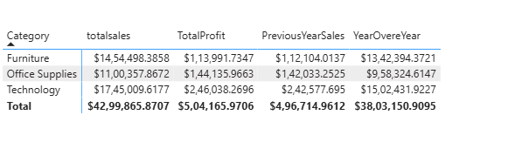

Slide 19
Page 1 – Sales Overview: What · Why · How
Section 4 · Visual Explanation
💰 KPI Card – Total Sales
📦 KPI Card – Total Quantity
WHAT
Displays the [totalsales] DAX measure as a single large number.
WHAT
Shows the aggregated SUM(Orders[Quantity]) across all orders.
WHY
Immediately communicates the headline revenue figure at a glance.
WHY
Quantifies volume independently of revenue – useful for unit economics.
HOW
Card visual bound to Orders[totalsales].
HOW
Card visual using implicit SUM aggregation on Quantity field.
📊 Column Chart – Sales by Region
🗂️ 100% Stacked Bar – Sales by Category & Country
WHAT
Vertical bars comparing total sales for each geographic region.
WHAT
Shows the proportional split of sales by product category, coloured by country.
WHY
Easy comparison of regional performance; bar length encodes magnitude precisely.
WHY
Reveals how each product category's country mix compares – part-to-whole insight.
HOW
Column chart · X: Geo Hierarchy[Region] · Y: SUM(Sales). Drill-down enabled.
HOW
Stacked bar · Category: DimProduct[Category] · Y: Sales · Series: Country. Labels on.
📈 Combo Chart – Sales & Profit by Sub-Category
🟦 Treemap – Quantity by Country
WHAT
Columns for Sales and a line overlay for Profit across product sub-categories.
WHAT
Nested rectangles showing the proportional quantity sold in each country.
WHY
Dual-axis allows profit margin to be compared against sales volume in one view.
WHY
Treemap handles many geographic values efficiently, showing size hierarchy visually.
HOW
lineStackedColumnComboChart · Y: SUM(Sales) · Y2: SUM(Profit) · Cat: Sub-Category.
HOW
Treemap · Group: Geo Hierarchy[Country] · Values: SUM(Quantity). Area encodes volume.
Power BI · Group Work Data Analysis Report

Slide 20
Page 2 – Profit Analysis: What · Why · How
Section 4 · Visual Explanation
🍩 Donut Chart – Profit by Market
💹 KPI Card – Total Profit
WHAT
Circular chart showing each market's share of total profit.
WHAT
Single big-number card for the [TotalProfit] DAX measure.
WHY
Donut charts excel at part-to-whole proportions; the hole reduces clutter vs. a full pie.
WHY
Provides an immediate profit headline to anchor the page narrative.
HOW
Donut · Y: SUM(Profit) · Category: Orders[Market]. Legend shows market names.
HOW
Card visual · Values: Orders[TotalProfit] measure. Custom format string applied.
📋 Pivot Table – Category P&L
📉 Combo Chart – Sales vs PrevYr by Region
WHAT
Cross-tab showing Category rows vs Sales, Profit, Prev Year Sales, and YoY columns.
WHAT
Clustered columns for current Sales + previous year Sales, with a line series per Category.
WHY
Tables are ideal for precise numeric comparison; analysts can read exact figures.
WHY
Dual-series comparison highlights which regions grew or declined year-over-year.
HOW
Matrix visual · Rows: Category · Values: Sales, Profit, PreviousYearSales, YearOvereYear.
HOW
lineClusteredColumnComboChart · Y: SUM(Sales) · Y2: PreviousYearSales · Series: Category.
📐 Area Chart – YoY Growth Over Time
🔍 Year Slicer
WHAT
Area chart showing YearOvereYear % and PreviousYearSales across calendar years.
WHAT
Interactive filter that lets the viewer select a specific year.
WHY
Area fills emphasise cumulative trend; overlapping bands show two time series at once.
WHY
Cross-filters all visuals on the page, enabling dynamic what-if year exploration.
HOW
Area chart · X: Date[Year] · Y: YearOvereYear · Y2: PreviousYearSales. Dual axis.
HOW
Slicer · Values: Orders[Order Date] Year hierarchy. Basic mode, single-select.
Power BI · Group Work Data Analysis Report

Slide 21
05
VISUAL ENCODING
Pre-attentive attributes & design principles applied

Slide 22
